Slide 1
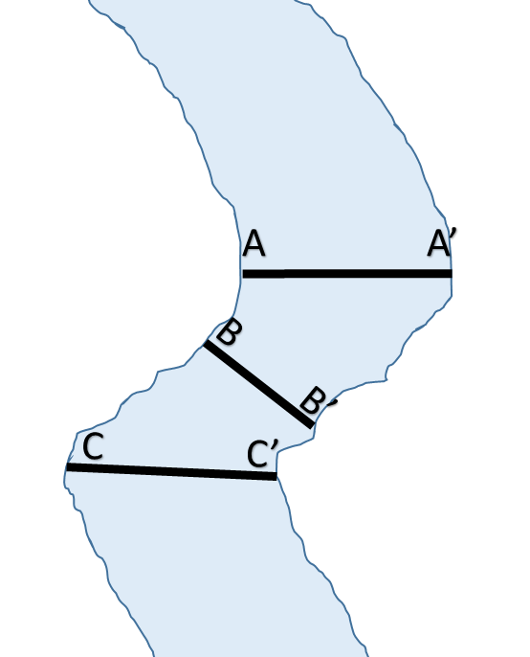
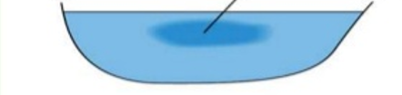
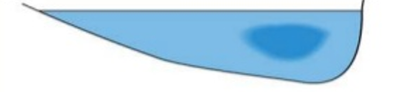
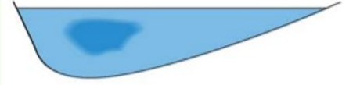
V
V
Part Name:
Water Speed:
(Circle) Shallow or Deep
(Circle) Deposition or Erosion
Part Name:
Water Speed:
(Circle) Shallow or Deep
(Circle) Deposition or Erosion
V
Part Name:
Water Speed:
(Circle) Shallow or Deep
(Circle) Deposition or Erosion
Part Name:
Water Speed:
(Circle) Shallow or Deep
(Circle) Deposition or Erosion
Area of:
Fast
Slow
Sallow
Deep
Deposition
Erosion
Fast
Slow
Shallow
Deep
Deposition
Erosion
A
A’
Fast
Slow
Shallow
Deep
Deposition
Erosion
B
B’
C
C’

